Slide 1

Department of Computer Science
University Institute of Engineering
DEPARTMENT OF COMPUTER SCIENCE & ENGINEERING
Bachelor of Engineering
Subject Name: System Programming
Subject Code: CST-315
Assemblers
DISCOVER . LEARN . EMPOWER

Slide 2
Chapter-1 Overview of System Software
Department of computer Science
Introduction
Software
Software Hierarchy
System Programming

Slide 3
Introduction-Software
Software means set of computer Program to perform a task.
A program is set of instructions.
A computer system consists of two components; Hardware (the physical component of which includes keyboard, mouse, printer etc) and the software (the electronic working components). Hence, software is indispensable for any computer system

Slide 4
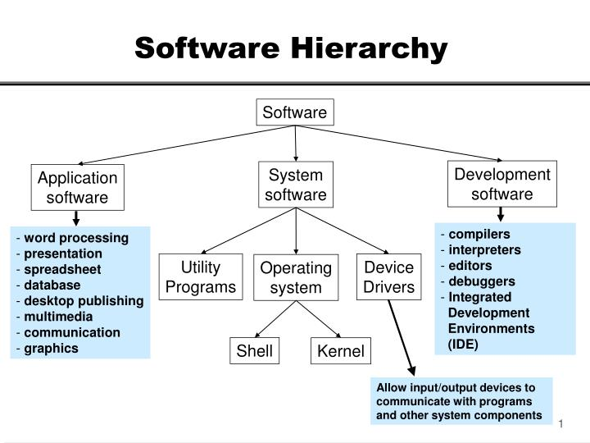

Slide 5
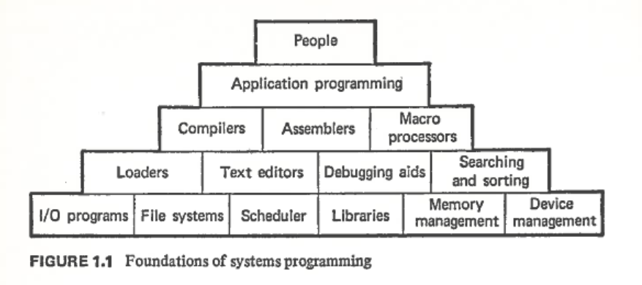

Slide 6
Categories of Software
Software is categorized into
Systems software and
Applications software.
Development Software
-Systems Software refers to set of programs that coordinates activities and functions of the hardware and various other programs. It is operating system and all utility programs that manage computer resources at a low level.
The systems software consists of
operating systems
Utility systems
Devices drivers and
programming languages.
Operating system refers to the system which runs a computer. Operating systems consist of the master system of programs that manage the basic operations of the computer.. Examples of OS for the PC include Windows, Unix etc.
Utility Software- Utility software (a type of system software) is designed to help you monitor and configure settings for your computer system equipment, the operating system, or application software.
Backup, Compression, Defrag
A desktop widget is a specialized utility program that appears on a computer’s screen-based desktop

Slide 7
Systems Software
Device Drivers . A device driver is software that helps a peripheral device establish communication with a computer. Eg., Windows Device Manager, Printer Device Drivers.
The Programming Languages refers to coding schemes used to write both systems and application software
Hence, systems software refers to the operating system and all utility programs that manage computer resources at a low level. The system software serves the application, which in turn serves the user.
Systems software: coordinates the activities and functions of hardware and programs

Slide 8
Operating Systems Functions
User interface and input/output management
User interface: allows individuals to access and command the computer system
Command-based user interface: requires that text commands be given to the computer to perform basic activities
Graphical user interface (GUI): uses icons and menus displayed on screen to send commands to the computer system
Hardware independence
Application program interface (API): allows applications to make use of the operating system
Memory management
Control how memory is accessed and maximize available memory and storage

Slide 9
Operating Systems Functions
Processing tasks
Multitasking: more than one program can run at the same time
Time-sharing: allows more than one person to use a computer system at the same time
Scalability: ability of the computer to handle an increasing number of concurrent users smoothly
Networking capability
Features and capabilities of the OS that aid users in connecting to a computer network
Access to system resources and security
Protection against unauthorized access
Logins and passwords
File management
Ensures that files in secondary storage are available when needed and that they are protected from access by unauthorized users

Slide 10
Applications Software
Application software is all the computer software that causes a computer to perform useful tasks beyond the running of the computer itself. A specific instance of such software is called a software application, application program, application or app.
Applications software comprises programs designed for an end user.
Examples
accounting software enterprise
Graphics software,
media players,
word processors, database systems, and spreadsheet programs.
Figuratively speaking, applications software sits on top of systems software because it is unable to run without the operating system and systems utilities.

Slide 11
Types of Applications Software
Application software can also be seen as being either horizontal or vertical.
Horizontal applications are more popular and widespread, because they are general purpose, for example word processors or databases.
Vertical applications are niche products, designed for a particular type of industry or business, or department within an organization. Integrated suites of software will try to handle every specific aspect possible of, for example, manufacturing or banking systems, or accounting, or customer service.

Slide 12
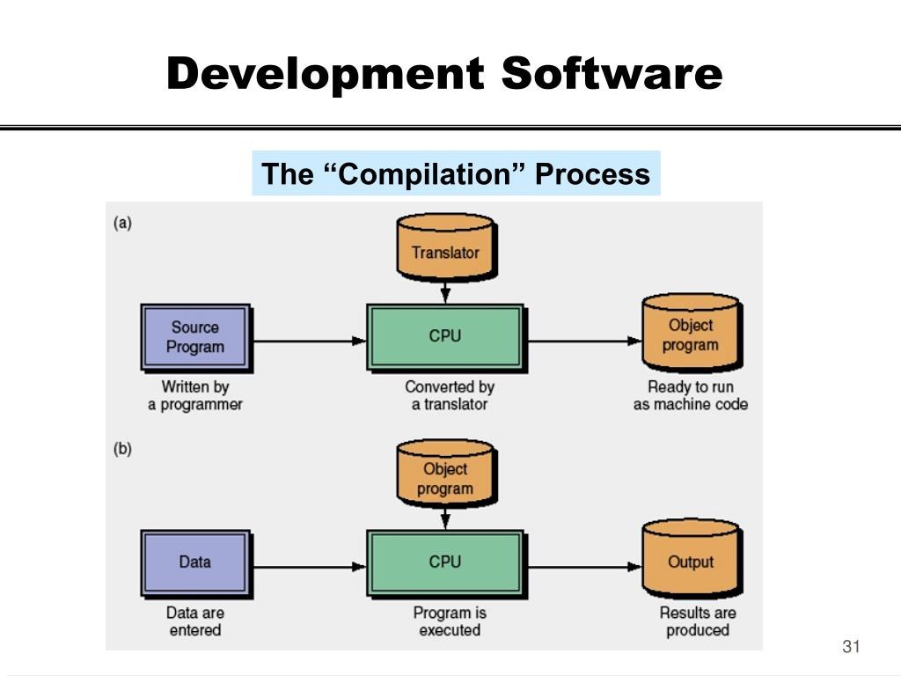
:

Slide 13
System Programming
System programming (or systems programming) is the activity of programming the system software. The primary distinguishing characteristic of systems programming when compared to application programming is that application programming aims to produce software which provides services to the user (e.g. word processor), whereas systems programming aims to produce software which provides services to the computer hardware (e.g. disk defragmenter). It requires a greater degree of hardware awareness.
An example is an operating system, which usually acts as the interface between the user, the application software, and computer hardware. The OS provides an environment that enables users to execute other programs efficiently. Comprising of a set of system programs, the operating system functions include storage management, file handling, memory management, CPU and device scheduling and management, error handling, process control and more.

Slide 14
References
Introduction to Computer Software PowerPoint Presentation, free download - ID:5644955 (slideserve.com)
Introduction to software | computer Software (w3htmlschool.com)
Types of Software – GeeksforGeeks

Slide 15

THANK YOU

